Slide 1

Northeastern University - Seattle
CS6650 Building Scalable Distributed Systems
Vishal Rajpal

Slide 2
Week 8 – Microservices
Topics we will cover today:
Monoliths
Moving to Microservices
Characteristics of a microservices based system
Resilience
Circuit Breaker Pattern
Bulkhead Pattern

Slide 3
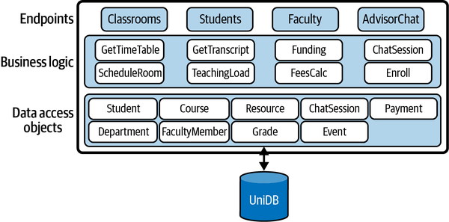
Monoliths
Example Monolith
Notes:
Since when IT systems came into existence, the monolithic architecture has dominated enterprise applications.
This style decomposes an application into multiple logical modules or services which are built and deployed as a single application.
They offer endpoints that can be called by clients.

Slide 4
Monoliths
Platforms such as IBM WebSphere and Microsoft .NET enable all services to be built and deployed as a single executable package.
APIs, business logic, data access, etc. are all wrapped up in a single deployment artifact.
Scale up is the simple
Scale out
Multiple copies of the monolith can be provisioned with a load balancer
Well understood architecture and design patterns
Single package to test
Single deployment to manage and monitor

Slide 5
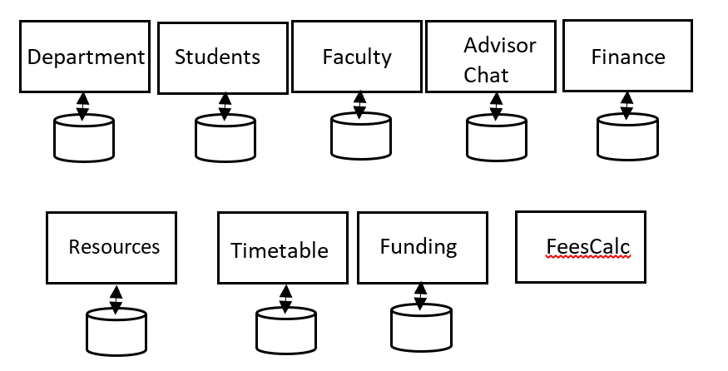
Moving to Microservices
Monoliths become problematic as system features and request volumes grow.
Code base complexity
Scale Out
Enter Microservices
Breaking up the Monolith
Notes:
Monoliths can start to become problematic as system features and request volumes grow. This problem has two fundamental elements:
Code base complexity
As the size of the application and engineering team grows, adding new features, testing, and refactoring become progressively more difficult. Technical debt can increase, and without significant investments in engineering, the code becomes more and more fragile. Development cadence increases for rolling out new features.
Scaling out means replicating the entire application (the monolith) every time. In the university management system, assume a sudden spike in the use of the AdvisorChat service occurs as support for mobile devices is released to the students. You can deploy new replicas to handle the chat message volume, but the new nodes need to be powerful and numerous enough to run the complete application. You can’t easily just pull out the chat service functionality and scale it independently.
This is where microservices enter the scene. They provide solutions to engineering and scale out challenges that monoliths almost inevitably face as the volume of requests grows rapidly.

Slide 6
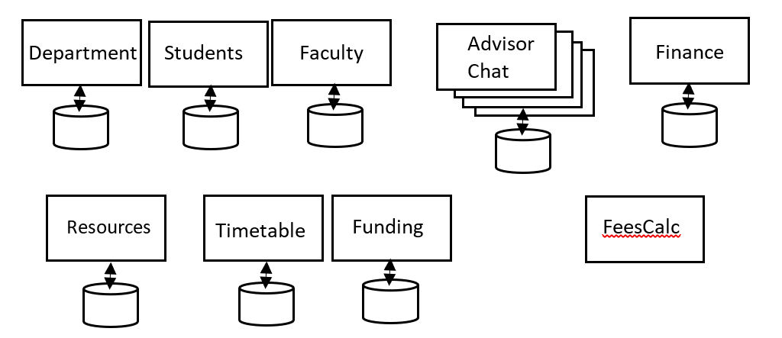
Characteristics of a microservices Based System
Microservices Advantages
Microservices offer the following advantages as systems grow in code size and request load:
Code base: an individual service should not be more complex than a small team size can build, evolve and manage
Scale Out: Individual microservices can be scaled out to meet request volume and latency requirements.
Similar to - A distributed system involves multiple entities talking to one another in some way, while performing their own operations.

Slide 7
Characteristics of a microservices Based System
Microservices Design – It’s about scope
Domain-Driven Design (DDD) provides a suitable method for identifying microservices
Bounded Contexts in DDD
Balancing act between the purity of the domain model and reality of the costs of distributed systems
Faculty and Funding
‘get funding by faculty’ or ‘find funding opportunities for faculty’
Merge Services.
Duplicate Data.
Duplicate data is a trade-off.
additional storage capacity and development effort
keeping duplicates consistent
DDD & Microservices: https://www.youtube.com/watch?v=yPvef9R3k-M
Notes:
One of the key design decisions when moving to a microservices architecture is how to decompose the system functionality into individual services. Domain-Driven Design (DDD) provides a suitable method for identifying microservices, as the necessarily self-contained nature of microservices maps well to the notion of Bounded Contexts in DDD. These topics are beyond the scope of this chapter but are essential knowledge for architects of microservice-based applications.
There is always a balancing act though. Microservices are by their very nature distributed. Often, the purity of the domain model needs to be analyzed and adjusted to meet the reality of the costs of distributed communications and the complexity of system management and monitoring. You need to factor in request loads and the interactions needed to serve these requests, so that excessive latencies aren’t incurred by multiple interactions between microservices.
For example, Faculty and Funding are excellent candidates for microservices. However, if satisfying requests such as ‘get funding by faculty’ or ‘find funding opportunities for faculty’ incur excessive communications, performance and reliability could be impacted. Merging microservices may be a sensible option in such circumstances. Another common approach is to duplicate data across coupled microservices. This enables a service to access the data it needs locally, simplifying the design and reducing data access response times.
Duplicate data is of course a trade-off. It takes additional storage capacity and development effort to ensure all duplicated data converges to a consistent state. Duplicate updates can be initiated immediately when data changes to attempt to minimize the time interval that the duplicates are inconsistent. . Alternatively, if the business context allows, periodic duplication (e.g., hourly or daily) can operate, perhaps executed by a scheduled task that is invoked when request loads are low. As the demands on performance and scalability on an application grow, the cost and complexity of duplicate data is typically small compared to the problems that a major refactoring of the system would present.

Slide 8
Characteristics of a microservices Based System
Deploying Microservices
Microservices need to be deployed easily and quickly.
Continuous Deployment & DevOps.
Serverless
Attractive microservices deployment approach.
A microservice can be built to expose its API on the serverless platform of your choice.
Serverless has 3 advantages
Deployment is simple – just upload the new executable package for your microservice to the endpoint that you have configured for your function.
Pay by usage – if your service has periods of low volume requests, your costs are low, even zero.
Ease of Scaling – the platform you choose handles scaling of your function. You control precisely how this works through configuration parameters, but the serverless option takes the heavy lifting out of scalability.
Example: AWS Lambda
Notes:
Containers - Everything needed to run the application is packaged inside the container object: code, run time, system tools, libraries and dependencies

Slide 9
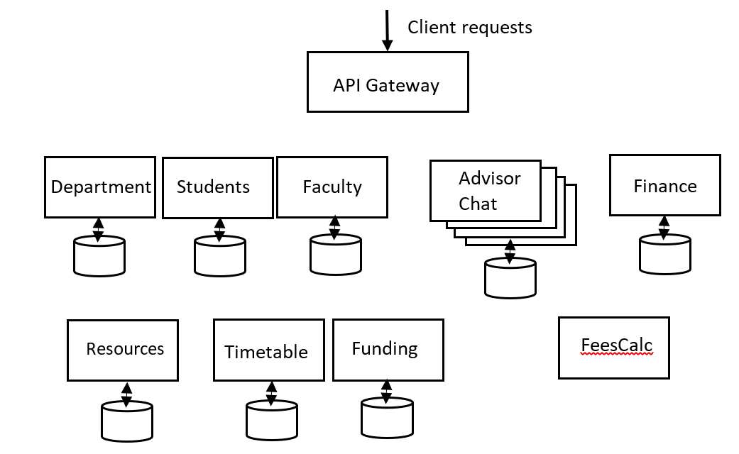
Characteristics of a microservices Based System
API Gateway
An API Gateway essentially acts as a single entry point for all client requests
Insulates clients from the underlying architecture of the microservices that implement the application functionality.
Example: https://aws.amazon.com/api-gateway/
Notes:
When you deploy all your microservices on a serverless platform, you expose multiple endpoints that clients need to invoke. This introduces complexity as clients need to be able to discover the location – host IP address and port – of each microservice. What if you decide to refactor your microservices by perhaps combining two in or order to eliminate network calls? Or move an API implementation from one microservice to another? Or even change the endpoint – IP address and port – of an API?
Exposing backend changes directly to clients is never a good idea. The Gang of Four book taught us this many years ago with the façade pattern in object-oriented systems. In microservices, you can exploit an analogous approach using the API Gateway pattern. An API Gateway essentially acts as a single entry point for all client requests, as shown in Figure 9-4. It insulates clients from the underlying architecture of the microservices that implement the application functionality. Now, if you refactor your underlying APIs or even choose to deploy on a radically different platform such as a private cloud, clients are oblivious to changes.

Slide 10
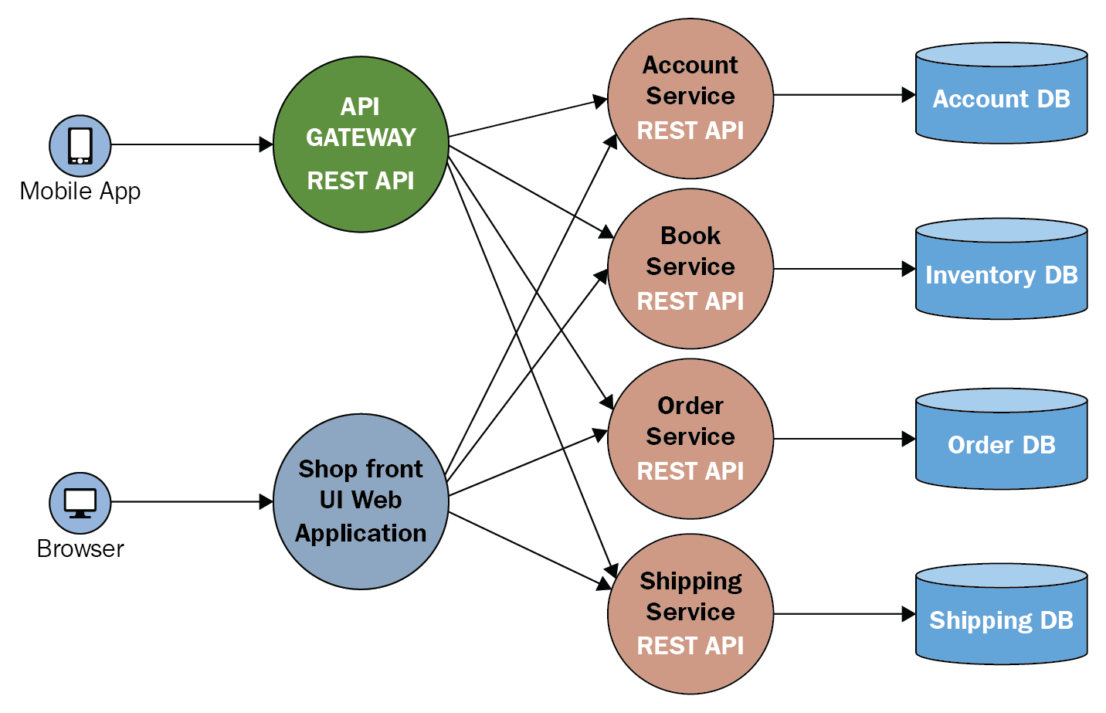
Characteristics of a microservices Based System
API Gateway
There are multiple API Gateway implementations
Proxy incoming client API requests with low millisecond latencies to backend
Provide authentication and authorization
Define rules for throttling each API.
Support a cache for API results
Integrate with monitoring tools
Notes:
Under heavy request spikes, there is of course the danger of the API Gateway becoming a bottleneck. How this is handled by your API Gateway is product specific. For example, AWS API Gateway has a 10K requests/second limit, with an additional burst quota of up to 5K requests/second. The Kong API Gateway is stateless, hence it is possible to deploy multiple instances and distribute the requests using a load balancer.

Slide 11
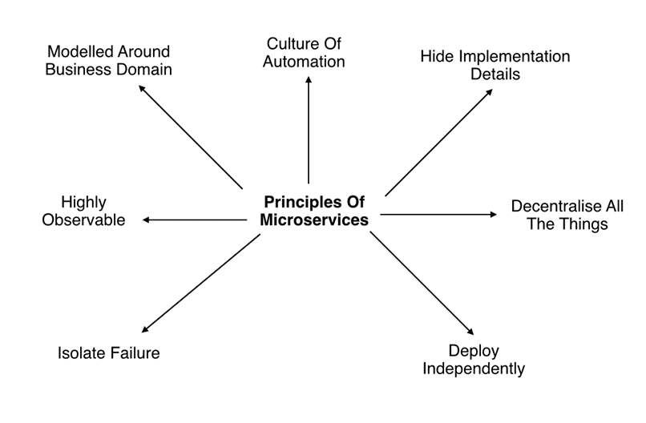
Characteristics of a microservices Based System
Microservices Principles
Modelled around a business domain
Highly Observable
Hide Implementation Details
Decentralize all the things
Isolate Failure
Deploy Immediately
Culture of Automation
Notes:
Modelled around a business domain: The notion of bounded contexts provides a starting point for the scope of a microservice. Business domain boundaries may need rethinking in the context of coupling between microservices and the performance overheads it may introduce.
Highly observable: Monitoring of each service is essential to ensure they are behaving as expected, processing requests with low latencies, and error conditions are logged. In distributed systems, observability is an essential characteristic for effective operations.
Hide implementation details: Microservices are black boxes. Their API is a contract which they are guaranteed to support, but how this is carried out is not exposed externally. This gives freedom for each team to choose development stacks that can be optimized to the requirements of the microservice.
Decentralize all the things: One thing to decentralize is the processing of client requests that require multiple calls to downstream microservices. These are often called workflows. There are two basic approaches to achieving this, namely orchestration and choreography.
Isolate failure: The failure of one microservice should not propagate to others and bring down the application. The system should continue to operate, although probably with some degraded service quality. Much of the rest of this chapter addresses this principle specifically.
Deploy independently: Every microservice should be independently deployable, to enable teams to roll out enhancements and modifications without any dependency on the progress of other teams.
Culture of automation: Development and devops tooling and practices are absolutely essential to gain the benefits of microservices. Automation makes it faster and more robust to make changes to the deployed system frequently. This frequency may be, for example, hourly or daily, depending on the system and the pace of development.

Slide 12
Characteristics of a microservices Based System
Summary so far
Applications comprise multiple communicating microservices
How do we decompose them?
Rules?
Methods?
Microservices are
Loosely coupled
Cohesive
Microservices typically:
Single responsibility
Small team (`10)
Independently deployable
Communications:
Reliable
Low latency
Principles of Microservices: https://www.youtube.com/watch?v=PFQnNFe27kU Sam Newman

Slide 13
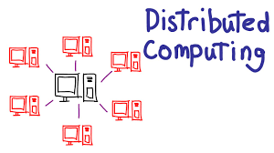
Characteristics of a microservices Based System
Scaling Microservices
At its core a microservices-based system is:
A distributed system
(A)synchronous communications
Distributed data repositories
Scaling is hard

Slide 14
Characteristics of a microservice Based System
Resilience in Microservices
What should a system do if just one microservice is down?
Reject request?
Degraded functionality?
Example
Users logs into music service
Personalization microservice that hold user preferences is unavailable?
What do we do?

Slide 15
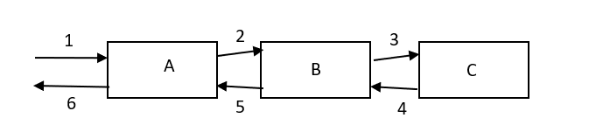
Characteristics of a microservices Based System
What if a service is slow?
A downstream service suddenly slows down
New requests keep arriving
We send these requests to the (calling) upstream service
It keeps waiting for the slow services
Notes:
Slide depicts a simple microservices architecture. A request arrives at microservice A. To process this request, it calls microservice B, which in turn calls microservice C. Once microservice C responds, B can return the results to A, which in turn can respond to the client. The numbers in the figure represent this sequence for an individual request.
Let’s assume that the request load on microservice A grows. This means A will exert more load on B, which will in turn exert more load on C. For some reason, such as lack of processing capacity or database contention, this causes the response times from microservice C to increase, which creates back pressure on B and causes it to respond more slowly to A.
If the increased load is sustained for a period of time, threads in the microservices A and B are blocked waiting for requests to be handled by downstream processing. Let’s assume microservice C becomes overloaded – perhaps the request pattern causes database deadlocks on frequently updated keys, or the network connection to C’s database becomes unstable. In an overloaded state, response times increase and B’s threads become blocked waiting for results. Remember from Week 2, application servers have fixed size thread pools. Once all threads in B are occupied making calls to C, if requests continue to arrive at high volumes, they will be queued until a thread is available. Response times from B to A start to grow, and in an instant all of A’s threads will be blocked waiting for B to respond.

Slide 16
Characteristics of a microservices Based System
Cascading Failures
A slow service causes requests to build up ‘upstream’
If we keep sending requests to the slow service
Will it get faster?
Requests on upstream service consume threads
Block as downstream service slow
Runs out of threads
It soon becomes unresponsive

Slide 17
Characteristics of a microservices Based System
Cascading Failures
Under heavy load, cascading failures can happen very quickly
We need to be tolerant to slow services
Why are slow services more evil than failed ones?
Retries don’t help
Detect slow services
Limit their scope for causing cascading failures
int retries = RETRY_COUNT;
while (retries > 0) {
try {
callDependentService();
return true;
} catch (RemoteCallException ex) {
logError(e);
retries = retries – 1;
}
return false;
Notes:
The insidious nature of cascading failures is that they are triggered by slow response times of dependent services. If a downstream service simply fails or is unavailable – a system crash or transient network failure – the caller gets an error immediately and can respond accordingly. This is not the case with services that gradually slow down. Requests return results, just with longer response times. If the overwhelmed component continues to be bombarded with requests, it has no time to recover and response times continue to grow.
This situation is often exacerbated by clients that, upon request failure, immediately retry the operation, as illustrated in the code snippet on the slde
Immediate retries simply maintain the load on the overwhelmed microservice, with very predictable results, namely another exception. Overload situations don’t disappear in a few milliseconds. In fact, they are likely to persist for many seconds or even minutes. Retries just keep the pressure on.
The retry example can be improved by techniques such as exponential backoff, namely inserting a growing delay between retries. This potentially can help relieve the downstream overload, but the delay becomes part of the latency experienced by the caller, which often doesn’t help matters.
Cascading failures are common in distributed systems. Whether caused by overwhelmed services, or error conditions such as bugs or network problems, there are steps you explicitly need to take to guard against them.

Slide 18
Characteristics of a microservices Based System
Timeouts – Fail Fast
If we wait ‘forever’ on a slow downstream service:
We consume resources (thread/connection)
Can cause service to become unresponsive
Hence:
Timeouts on all out of process calls
No blocking calls
Choose sensible defaults
If timeout occurs:
Log it
Tune timeout settings based on system behaviors
Design upstream ‘default’ functions to deal with failed request
Notes:
The core problem with slow services is that they utilize system resources for requests for extended periods. A requesting thread is stalled until it receives a response. For example, let’s assume we have an API that normally responds within 50ms. This means each thread can process around 20 requests per second. If one request is stalled for 3 seconds due to an outlier response time, then that’s (3*20)-1=59 requests that could have been processed.

Slide 19
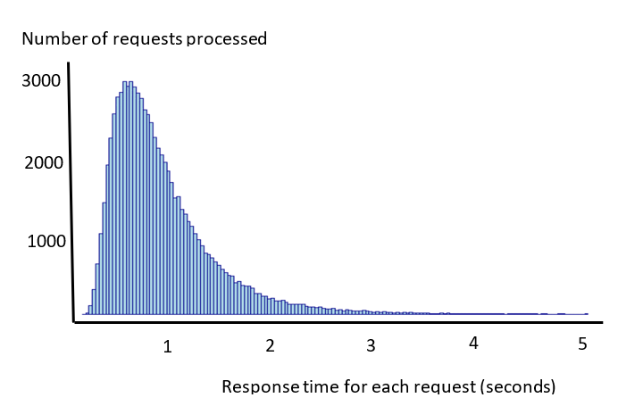
Characteristics of a microservices Based System
Long Tail Responses
Notes:
Even with the best designed APIs for a microservice, there will be outlier responses. Real workloads exhibit a long tail response time profile. A small number of requests take significantly longer – sometimes 20 or a 100 times more – than the average response time. This can be for a number of reasons. Garbage collection in the server, database contention, excessive context switching, system page faults, and dropped network requests are all common causes for this long tail.
As you can observe from this graph, the vast majority of requests have low response times, which is great. However, a significant number are over one second and a small number much, much slower, over 4 seconds in fact.

Slide 20
Characteristics of a microservices Based System
Percentiles
Typical pattern:
P50 – 200 milliseconds
P95 – 1200 milliseconds
P99 – 3000 milliseconds
Solution - fast fail.
When a request takes longer than e.g. p95 (?), client returns an error to its caller.
Enable throttling on a server. If load exceeds threshold, immediately fail the request with an HTTP 503 error.
Notes:
We can quantify the percentage of slow requests using percentiles. Percentiles give a far richer and more accurate view of response times from a microservice than averages. For example, if we measure response times and calculate percentiles under expected loads, we see as on the slide.
This means that 50% of requests are served in less than 200 milliseconds, 95% are served within 1200 milliseconds, and 99% percent within 3000 milliseconds. These numbers in general look pretty good. But let’s assume our API handles 200 million requests per day (approximately 2314 requests per second). This means 1%, or 2 million requests, take greater than 3 seconds, which is 15 times slower than the 50th percentile - the median. And some requests will be significantly longer than 3 seconds given the long tail response time pattern we see in Figure 9-6.
Long response times are never good things, technically or for client engagement. In fact, many studies have shown how longer response times have negative effects on system usage. For example, the BBC reported that it sees 10% less users for every additional second a page takes to load. Fast, stable response times are great for business, and one way to achieve this is to reduce the long tail. This also has the effect of decreasing the overall average response time for a service, as the average is skewed heavily by a small number of slow responses.
A common way to eliminate long response times is to fast fail. There are two main ways to achieve this:
When a request takes longer than some predefined time limit, instead of waiting for it to complete, the client returns an error to its caller. This releases the thread and other resources associated with the request.
Enable throttling on a server. If the request load exceeds some threshold, immediately fail the request with an HTTP 503 error. This indicates to the client that the service is unavailable.

Slide 21
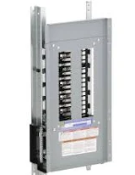
Circuit Breaker Pattern
Analogous to electrical system, If a power surge, the breaker blows to protect appliances
In software if there’s a traffic surge or a slow/dead downstream service
The breaker blows and stops sending requests
For HTTP requests, indicators are 5XX errors & Timeouts
Circuit breaker monitors % of failed calls
When threshold reached, it blows
New requests are:
Queued if appropriate
Fail fast
Circuit breaker waits a period and starts allowing requests through
How long?
If still fail?
If succeed?
Notes:
If a microservice starts to throw errors due to an overload situation, or a flakey network, it makes little sense to keep trying to send requests to the API. Rather than failing fast, which still incurs a timeout delay, it is better to back off immediately from sending further requests and allow some time for the error situation to resolve. This can be achieved using the circuit breaker pattern, which protects remote endpoints from being overwhelmed when some error conditions occur.

Slide 22
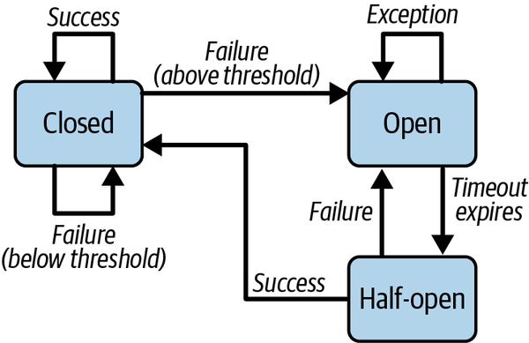
Circuit Breaker Pattern
Notes:
Just like in electrical systems, clients can use a circuit breaker to protect a server from overload. The circuit breaker is configured to monitor some condition, such as error response rates from an endpoint, or the number of requests sent per second. If the configured threshold is reached, for example 25% of requests are throwing errors, the circuit breaker is triggered. This moves the circuit breaker into an OPEN state, in which all calls return with an error immediately, and no attempt is made to call the unstable or unavailable endpoint.
The circuit breaker then rejects all calls until some suitably configured timeout period expires. At that stage, the circuit breaker moves to the HALF_OPEN state. Now the circuit breaker allows client calls to be issued to the protected endpoint. If the requests still fail, the timeout period is reset and the circuit breaker stays open. However, if the request succeeds, the circuit breaker transitions to the CLOSED state and requests start to flow to the target endpoint. This scheme is illustrated in Figure 9-7.
Circuit breakers are essential to reduce the resources utilized for operations which are almost certain to fail. The client fails fast, and the OPEN circuit breaker relieves load on an overwhelmed server by ensuring requests do not reach it. For overloaded services, this creates an opportunity to stabilize. When the service (hopefully) recovers, the circuit breaker resets automatically and normal operations resume.

Slide 23
Circuit Breaker Pattern
Apache EventCounterCircuitBreaker
EventCountCircuitBreaker breaker = new EventCountCircuitBreaker(1000, 1, TimeUnit.MINUTE, 800);
...
public void handleRequest(Request request) {
if (breaker.incrementAndCheckState()) {
// actually handle this request
} else {
// do something else, e.g. send an error code
}
}
EventCountCircuitBreaker breaker = new EventCountCircuitBreaker(5, 2, TimeUnit.SECOND, 5, 2, TimeUnit.SECOND);
...
public void handleRequest(Request request) {
if (breaker.checkState()) {
try {
service.doSomething();
} catch (ServiceException ex) {
breaker.incrementAndCheckState();
}
} else {
// return an error code, use an alternative service, etc.
}
}
Notes:
Imagine you have a server which can handle a certain number of requests per minute. Suddenly, the number of requests increases significantly - maybe because a connected partner system is going mad or due to a denial of service attack. A EventCountCircuitBreaker can be configured to stop the application from processing requests when a sudden peak load is detected and to start request processing again when things calm down. The following code fragment shows a typical example of such a scenario. Here the EventCountCircuitBreaker allows up to 1000 requests per minute before it interferes. When the load goes down again to 800 requests per second it switches back to state closed:
In this scenario, an application uses an external service which may fail from time to time. If there are too many errors, the service is considered down and should not be called for a while. This can be achieved using the following pattern - in this concrete example we accept up to 5 errors in 2 seconds; if this limit is reached, the service is given a rest time of 2 seconds:

Slide 24
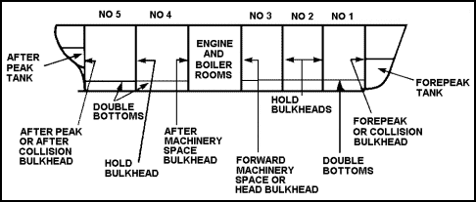
Bulkhead Pattern
Isolates requests into pools
If one fails/runs out of resources, others unaffected
Analogous to ship bulkheads
Notes:
The term bulkhead is inspired by large ship building practices. Internally the ship is divided into several physical partitions, ensuring if a leak occurs in one part of the boat’s hull, only a single partition is flooded and the boat, rather importantly, continues to float. Basically, bulkheads are a damage limitation strategy.

Slide 25
Bulkhead Pattern
Server (eg Tomcat) has multiple services
If one is latent, it will consume all threads
All services affected by single delayed service
Client may issue requests to many services simultaneously
Latent dependencies block client threads
Potential for client thread pool exhaustion for all service requests
Notes:
Imagine a microservice with two endpoints. One enables clients to request the status of their current orders placed through the service. The other enables clients to create new orders for products. In normal operations, the majority of requests are status requests, entailing a fast cache or database read. Occasionally, when a new popular product is released, a flood of new order requests can arrive simultaneously. These are much more heavyweight, requiring database inserts and writes to queues.
Requests for these two endpoints share a common thread pool in the application server platform they are deployed on in the microservice. When a new order surge arrives, all threads in the thread pool become occupied by new order creations, and status requests are essentially starved from gaining resources. This leads to unacceptable response times and potentially client calls seeing exceptions if a fail fast approach is used.

Slide 26
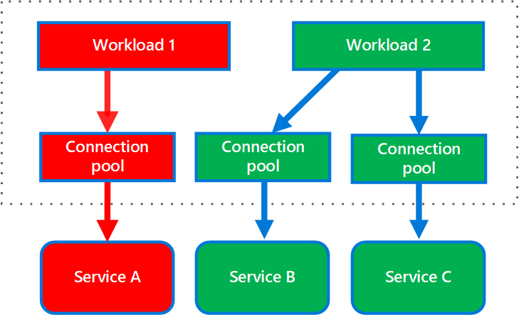
Bulkhead Pattern
Example
Notes:
Bulkheads help us solve this problem. We can reserve a number of threads in a microservice to handle specific requests. In our example, we could specify that the new order request has a maximum of 150 threads of the shared thread pool available for its exclusive use. This ensures that when a new order request burst occurs, we can still handle status requests with acceptable response times because there is additional capacity in the thread pool.
The following diagram shows bulkheads structured around connection pools that call individual services. If Service A fails or causes some other issue, the connection pool is isolated, so only workloads using the thread pool assigned to Service A are affected. Workloads that use Service B and C are not affected and can continue working without interruption.

Slide 27
Bulkhead Pattern
Example – Resilience4J
// configure the bulkhead
BulkheadConfig config = BulkheadConfig.custom()
.maxConcurrentCalls(150)
.maxWaitDuration(Duration.ofSeconds(1))
.build();
BulkheadRegistry registry = BulkheadRegistry.of(config);
// create the bulkhead
Bulkhead newOrderBulkhead = registry.bulkhead("newOrder");
// Create a supplier for OrderService.newOrder method
Supplier<OrderOutcome> orderSupplier = () ->
OrderService.newOrder(OrderInfo);
// decorate NewOrder with the bulkhead configuration
Supplier<OrderOutcome> bukheadOrderSupplier =
newOrderBulkhead.decorateSupplier(newOrderBulkhead, orderSupplier);
Notes:
The Java Resilience4j library provides an implementation of the bulkhead pattern using the functional programming features of Java 8 onwards. The bulkhead pattern segregates remote resource calls in their own thread pools so that a single overloaded or failing service does not consume all threads available in the application server.
The following example code shows how to create a bulkhead that allows a maximum of 150 concurrent requests. If 150 threads are in use for the service that you wish to restrict with the bulkhead, requests will wait a maximum of 1 seconds before the default BulkheadFullException exception is thrown.
Next, you specify that the OrderService.newOrder() method should be decorated with the bulkhead. This ensures that a maximum of 150 invocations of this method can occur concurrently.

Slide 28
Bulkhead Pattern
Example – Spring boot
server:
tomcat:
threads:
max: 200
resilience4j.bulkhead:
instances:
OrderService:
maxConcurrentCalls: 150
maxWaitDuration: 1000ms
@Bulkhead(name = "OrderService", fallbackMethod = “newOrderBusy”)
public OrderOutcome newOrder(OrderInfo inf){// details omitted}

Slide 29
Summary
Microservices are a dominant architecture for scalable systems
Loosely Coupled, cohesive, distributed
Resilience and Cascading Failures
Circuit Breaker Patterns
Bulkhead (Isolation) Pattern

Slide 30
Questions?

